Slide 1
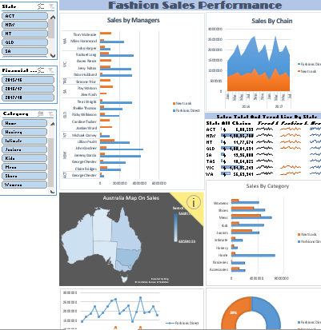
EXCEL DASHBOARD PROJECT
Created By:-
Prasad Nawale
DashBoard:-

Slide 2
Fashion Sales Performance
The Fashion Sales Dataset Is Taken From Kaggle Dataset.
It consist of Performance of Various Fashion Stores in Australia.
The Link Of This Dataset Is Given Below:-
https://www.kaggle.com/xv56ghbkli/fashion-sales?select=fashionsales.xlsx

Slide 3
Several problem statements
1. Sales by Manager.
2. Monthwise Sales Growth.
3. Comparison Between Two Chains.
4. Sales By Category.
5.Table For Explaining TrendLine.
6. StateWise Total Sales Comparison.
7. FieldMap Chart For Sales Performance around country.
8 .Sales By Chain.
9. Product sold by every managers sales.
10. LineChart for Comparison Between Chains.
11. We Can Easily Filters Data by Using Slicers.

Slide 4
Analysis & results
1.Sales By Managers.
2.Product Sold By Every Manager Sales.

Slide 5
3. Monthwise Sales Growth.

Slide 6
4.Comparison Between Chains.

Slide 7
5. Sales By Category.

Slide 8
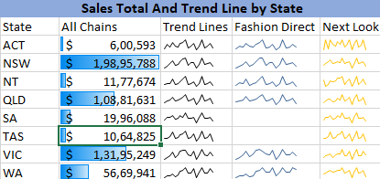
6. Table for explaining Trendline.
7.StateWise Total Sales Comparison

Slide 9
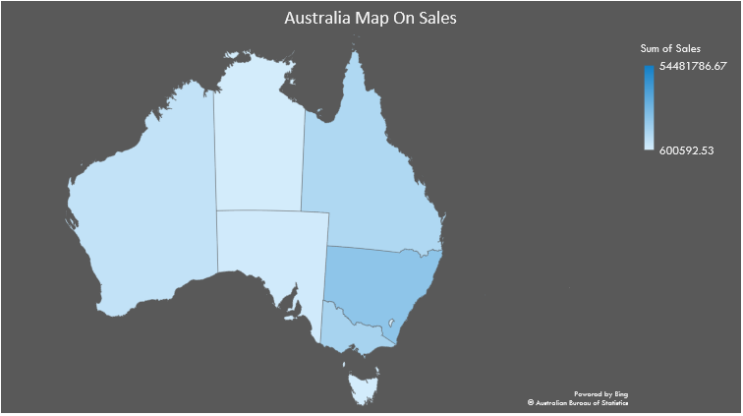
8. Fieldmap chart for explaining Sales performance around Country.

Slide 10
9.Sales By Chains.

Slide 11
Conclusion :-
1. This Dashboard gives you any types of information of Fashion Sales very easily.
2. We Can Strive For Better Performance Of This Dataset Easily Through This Analysis.
Presentation Link:-
https://drive.google.com/drive/folders/1kognigUQs39-vQ_tk93o0DNB6SW_PtuV?usp=sharing

